Slide 1
JAVASCRIPT Methods
CIT 260:03 – Mobile application development

Slide 2
JavaScript Methods
JavaScript methods are the actions that can be performed on objects.
A JavaScript method is a property containing a function definition.

Slide 3
JavaScript Methods
JavaScript methods are the actions that can be performed on objects.
A JavaScript method is a property containing a function definition.
They are functions stored as object properties.

Slide 4
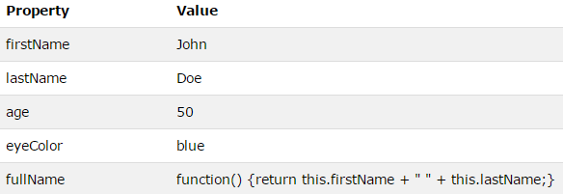
JavaScript Methods

Slide 5
Accessing Object Methods
We create an object method with the following syntax:

Slide 6
Accessing Object Methods
We access an object method with the following syntax:

Slide 7
Accessing Object Methods
We will typically describe fullName() as a method of the person object, and fullName as a property.
The fullName property will execute (as a function) when it is invoked with ( ).

Slide 8

Accessing Object Methods
This example accesses the fullName() method of a person object:

Slide 9
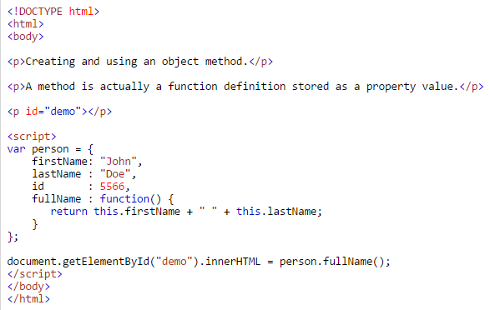
Accessing Object Methods

Slide 10

Accessing Object Methods
This example accesses the fullName() method of a person object:

Slide 11
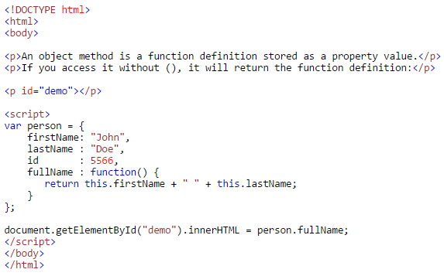
Accessing Object Methods

Slide 12

Using Built-In Methods
This example uses the toUpperCase() method of the String object, to convert a text to uppercase:

Slide 13
Using Built-In Methods
The value of x, after execution of the code above will be:

Slide 14
Adding New Methods
Adding methods to an object is done inside the constructor function.

Slide 15
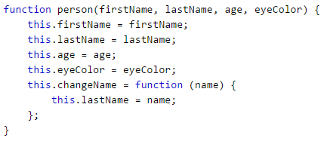
Adding New Methods
Example:

Slide 16

Adding New Methods
The changeName( ) function assigns the value of name to the person's lastName property.

Slide 17
Adding New Methods
JavaScript knows which person you are talking about by "substituting" this with myMother.

Slide 18
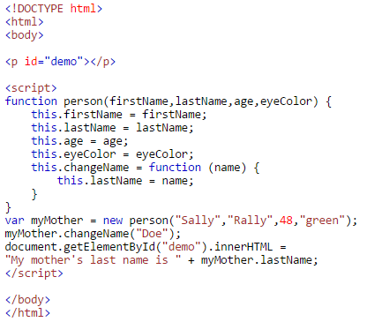
Adding New Methods

Slide 19
JAVASCRIPT Methods
Source: http://www.w3schools.com/js/js_object_methods.asp

